Slide 1
Youtube Trending Videos
Matthew Hagarty,
Cody Westbrook,
Evan Zhou

Slide 2
Outline
What are the key differences and similarities in trending video between France, US, and Japan?
What are the popularity rankings of video genres for 2020, 2021, and 2022? Have they changed?
Yearly Graphs
Cumulative Graphs on engagement
Specific Years/Months/Days of highest engagement
5.
6.
7.

Slide 3

Proposal
YouTube is one of the largest platforms for sharing and discovering videos worldwide. The YouTube trending page displays the most popular and engaging videos at any given time. This proposal proposes to analyze trending YouTube videos to understand the key similarities and differences in trending video genres between France (EU), US (NA), and Japan (Asia)?

Slide 4
Question 1
What are the popularity rankings of video genres for 2020, 2021, and 2022? Have they changed?

Slide 5
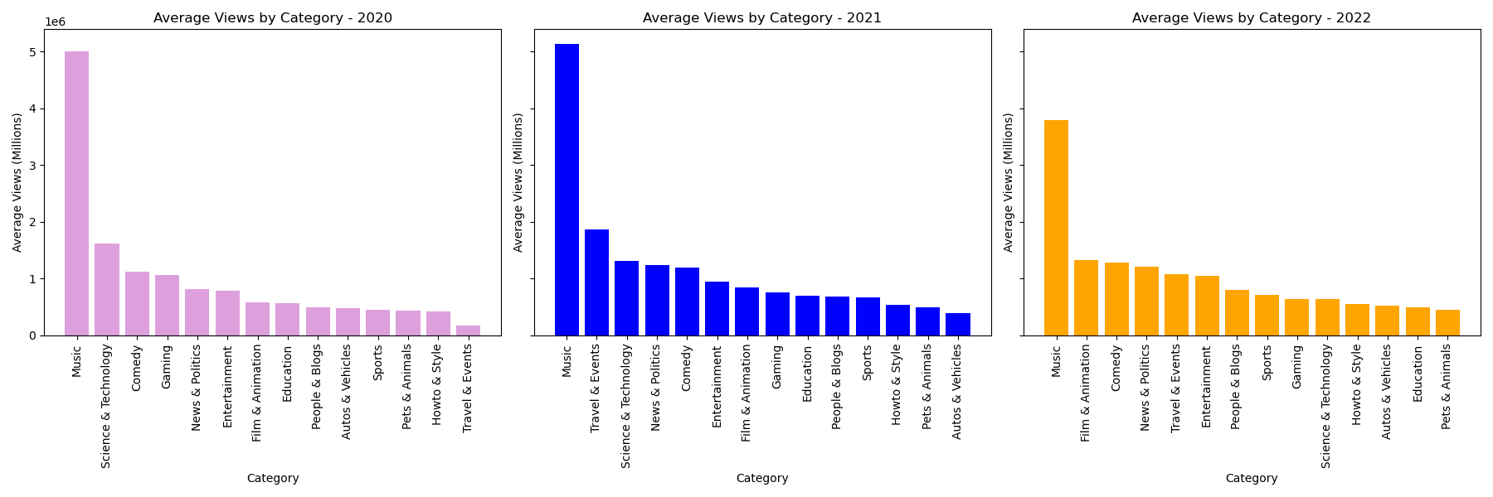
Japan (Asia)

Slide 6
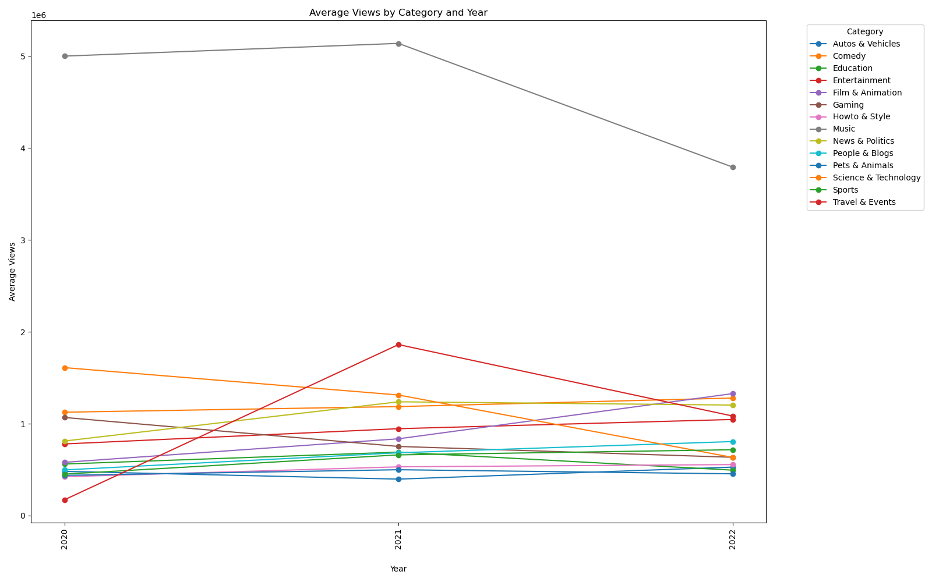
Japan (Asia)

Slide 7
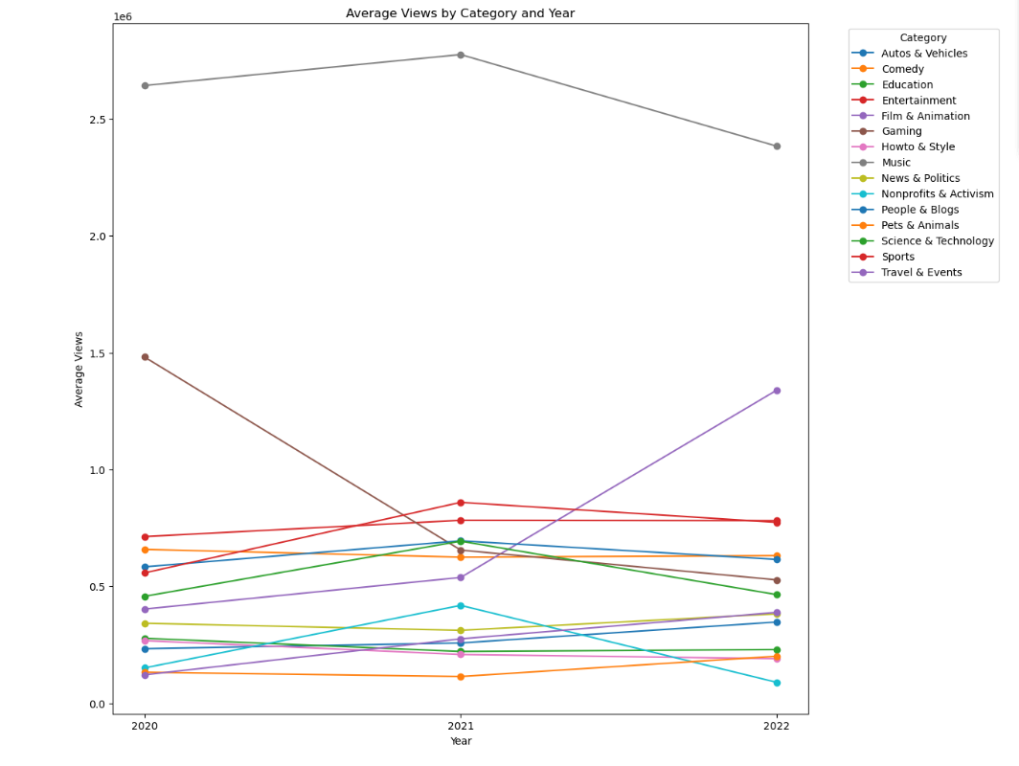
France (Eu)

Slide 8
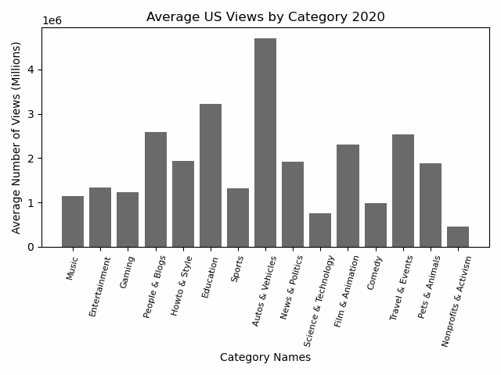
US (NA)

Slide 9
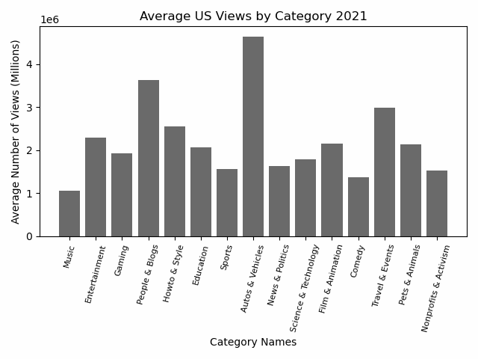
US (NA)

Slide 10
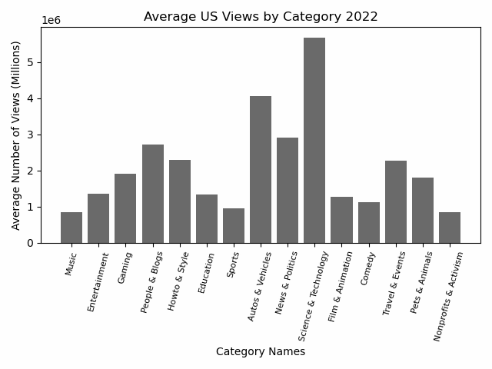
US (NA)

Slide 11
Question 2
What are the most popular genres per country
(Throughout 2020 to 2022)?

Slide 12
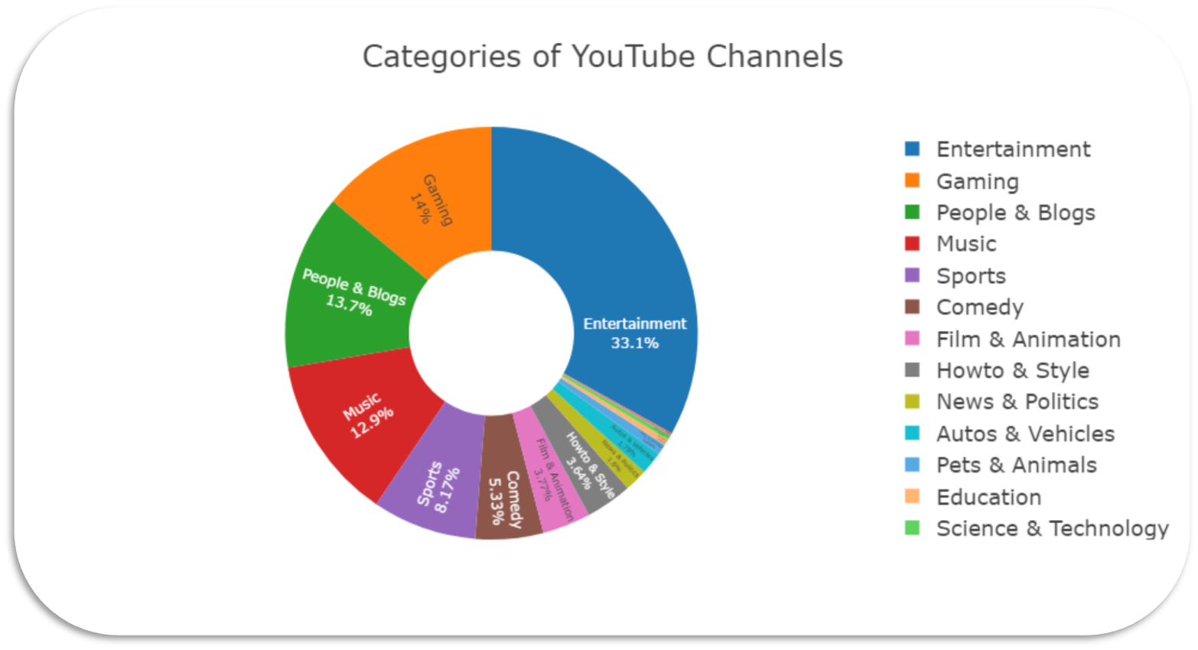
Japan (Asia)

Slide 13
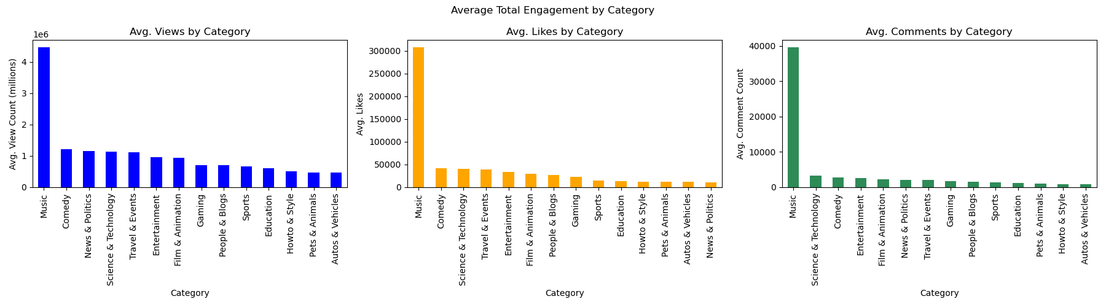
Japan (Asia)

Slide 14
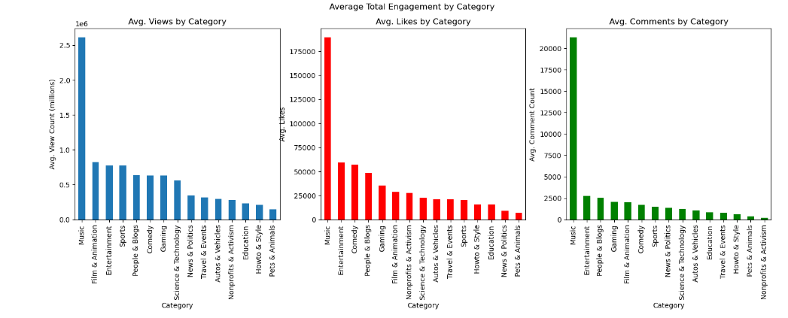
France (Eu)

Slide 15
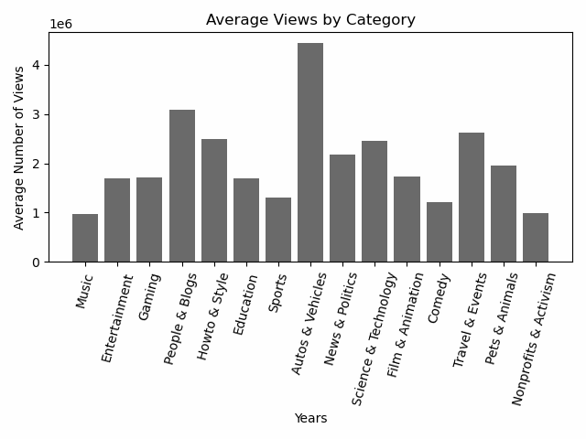
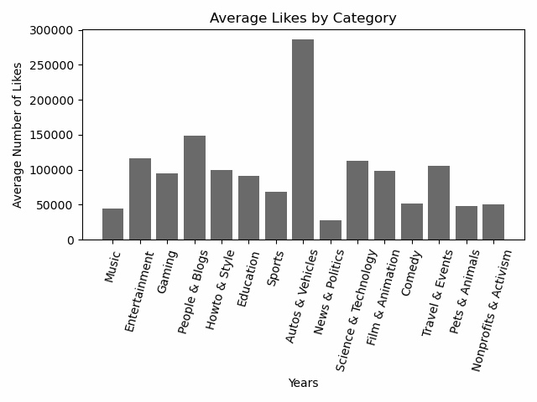
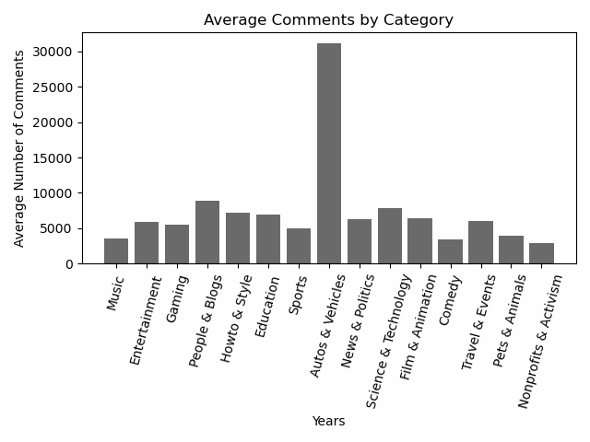
US (NA)

Slide 16
Analysis
Similarities
The dominant category across for Japan, and France is Music.
The unique music scenes and rich cultural heritage of both countries contribute to the sustained popularity of music-related content.
Differences
In the US, the dominant category is Auto & Vehicles.
This reflects a strong interest in automotive content, influenced by the country's car culture and fascination with vehicle technology.

Slide 17


